Slide 1


Social Anxiety
[Professor Name]
[Class and Section Number]
Notes:
Classroom Recommendations: This PPT module is to be presented in two 50-minute class periods. The first class period will cover the first three bullet points of the Overview slide and the Safety Behaviors activity. The second class period will cover the remaining three bullet points of the Overview slide and the Case Studies activity.
Overview: The goals of this module are to (1) differentiate between social anxiety and social anxiety disorder, (2) describe four ways in which the behavior of someone with social anxiety disorder may differ from “normal” (fear of evaluation, biased attention, deficient positive experiences, and problematic emotion regulation), and (3) describe treatment options for social anxiety disorder. In describing the critical (theoretical) components of SAD, the module allows students to reflect meaningfully on how their own perspective of the world may be different than that of someone suffering from SAD. In teaching this module, the most important point to emphasize with students may be the conclusion that better understanding of our own and others’ behaviors will ultimately lead to better functioning interpersonal relationships.
Technical Note: These slides may contain simple click animation so that you can focus students’ attention on a particular question, a selection of text, or an image and not have them be distracted by reading ahead. You can either preview the sequence of animation by going through the slides in slideshow view, visiting the animations tab, or reviewing the slide notes. In the notes you will see a cue - (Click) – that corresponds to each animation.
You may also find hyperlinks to outside videos at various places in the slides. These hyperlinks are embedded in text and indicated by color and in the notes section.

Slide 2
Learning Objectives
Distinguish social anxiety from social anxiety disorder.
Identify commonly feared social situations.
Know the prevalence and treatment rates of social anxiety disorder.
Understand how social anxiety influences thoughts, feelings, and behaviors.
Identify effective treatments for social anxiety disorder.
Notes:
This slide outlines the learning objectives of the module.

Slide 3
Warm-Up Activity
Instructions:
Take out a sheet of paper and number it 1-6.
You will be asked to imagine yourself in a particular scenario.
Then you will be asked a series of questions about how you might feel in that scenario. Write your answers on your paper.
Notes:
The purpose of this slide is to introduce an activity which will engage students in reflection about their own levels of anxiety regarding different types of events.
Total activity time: 10 minutes
Notes
Read the instructions to the students.
Allow them 1-2 minutes to prepare their answer sheet.

Slide 4

Scenario:
You are sitting in class, dosing off a little. Suddenly, the professor calls on you. The professor asks you to come to the front of the room and give a 5-minute presentation about the paper you were supposed to read for homework. The problem is that you were busy with an assignment for another class and you haven’t read the paper for this class.
Notes:
This slide outlines the scenario for the warm-up activity. You may have students read this silently or you may read it aloud to them.

Slide 5
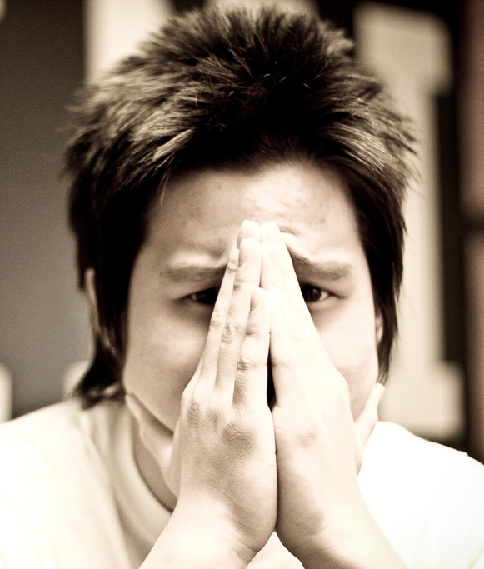
Questions:
For each of the questions below, rate how you would feel in this scenario right now. The scale is:
1 = Not at all 2 = Somewhat
3 = Moderately 4 = Very Much
I would feel calm.
I would feel tense.
I would feel upset.
I would feel relaxed.
I would feel content.
I would feel worried.
Notes:
This slide presents the questions for the warm-up activity. Give students 1-2 minutes to read through and answer the questions.
Then, read each question aloud and ask them to raise their hands if they answered 3 or 4 (for the positively valenced items (1, 4, & 5). Encourage students to take note of how many people feel comfortable with this scenario (hands raised) versus uncomfortable (hands down). Then, for each negatively valenced question, have students raise their hands if they answered 1 or 2 (items 2, 3, & 6). Again, encourage students to take note of their own and their peers’ responses.
This activity is used as a jumping-off point to define social anxiety and to point out that such anxiety is normal in our everyday lives.
These questions are a short-form version of the Spielberger State-Trait Anxiety Inventory (Marteau & Bekker, 1992)
Reference:
Marteau, T.M. & Bekker, H. (1992). The development of a six-item short-form of the state scale of the Spielberger State-Trait Anxiety Inventory (STAI). British Journal of Clinical Psychology, 31, 301-306.

Slide 6
Overview
What is social anxiety?
How is social anxiety different from social anxiety disorder?
Safety Behaviors
Facts about social anxiety disorder
Components of Social Anxiety Disorder
  Fear of Evaluation
  Biased attention and interpretation
  Deficient Positive Experiences
  Problematic Emotion Regulation
Treatment
Notes:
The purpose of this slide is to provide students with an overview of the material that will be covered during the lecture

Slide 7
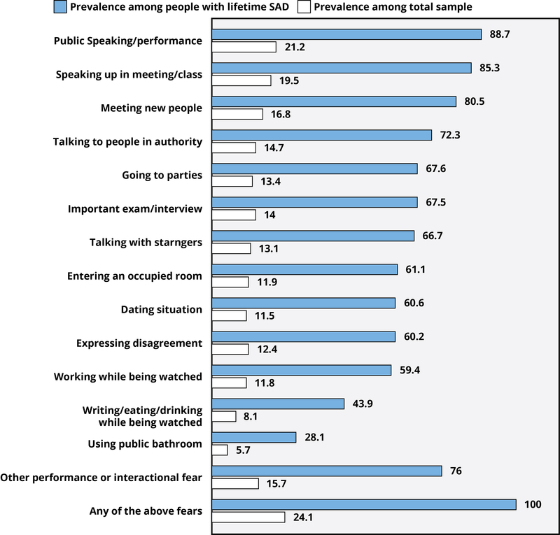
What is Social Anxiety?
Notes:
The purpose of this slide is to illustrate the different situations in which one might experience social anxiety. This provides a platform for defining social anxiety, discussing its normality, and introducing social anxiety disorder (SAD).
Define anxiety: general fear/apprehension about a future event (not a reaction to an immediate threat)
Define Social Anxiety: Excessive concern about being in social situations where scrutiny is likely
Explain key parts of the graph and relate it to their own answers on the warm-up activity
The white lines represent the percentage of people that experience social anxiety during these different situations. The top situation people claim as making them feel anxious is public speaking and in close second, speaking up in a meeting or in class.
You may have noticed that, when we went over the example at the beginning of class, the majority of you also reported that you might feel worried, tense, or upset if you were called on unexpectedly in class and were unprepared to answer the question.
Ask the students: which of these other situations might also make you feel nervous (select a student who feels comfortable sharing).
The blue lines represent the percentage of people with social anxiety disorder that feel anxiety in each of these situations.
The highest reported situation for people suffering from SAD is also public speaking. But you’ll notice that, across all of these situations, the percentages are much higher for SAD sufferers than for everyone else. See the last bar? “Any of the above fears”? This blue bar being at 100% means that people with social anxiety disorder have anxiety not just in one of these situations, but in several of them.
In fact, most SAD sufferers report fear and anxiety in at least 8 different social situations.
This brings us to a really important point in differentiating social anxiety from social anxiety disorder. While it is normal for people to suffer anxiety in different social situations, most of us engage in those situations anyway and then deal with the positive or negative consequences afterward. For people suffering from social anxiety disorder, they not only suffer anxiety in social situations but they also go to great lengths to avoid the discomfort or anxiety of those situations.
Reference:
Ruscio, A. M., Brown, T. A., Chiu, W. T., Sareen, J., Stein, M. B., & Kessler, R. C. (2008). Social fears and social phobia in the USA: Results from the National Comorbidity Survey Replication. Psychological Medicine, 38(1), 15–28. doi:10.1017/S0033291707001699

Slide 8
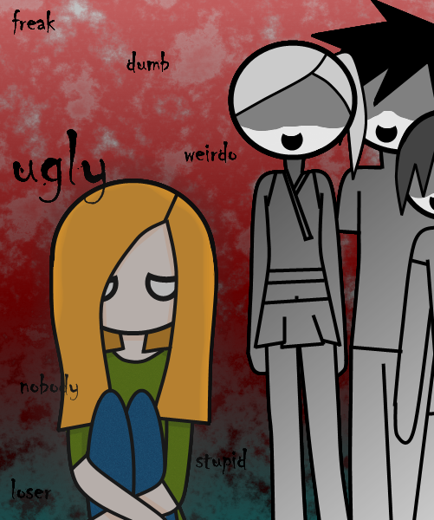
Difference Between
Social Anxiety and a Disorder
Fear of multiple social situations enduring ≥ 6 months
SAD sufferers engage in avoidance behaviors
Notes:
The purpose of the slide is to differentiate social anxiety from social anxiety disorder
(Click): Fear of multiple social situations enduring >= 6 months
According to the DSM-V, a diagnosis of SAD can be made when a person suffers debilitating anxiety across multiple situations for at least the past 6 months. However, for most SAD sufferers, the condition is chronic and may develop as early as adolescence.
(Click): SAD sufferers engage in avoidance behaviors
The hallmark of SAD is not necessarily the presence of anxiety in social situations. What makes the behaviors a disorder is the impairment in functioning that results from implementing avoidance behaviors meant to avoid the anxiety related to these situations. For example, if a person has trouble being with strangers or interacting with large groups, they may avoid taking public transportation to/from work (which may be their only option). These avoidance behaviors can be referred to as “safety behaviors”

Slide 9

Safety Behaviors
Actions people take to reduce likelihood of embarrassment or minimizing anxiety in a situation (e.g., not making eye contact, planning what to say).
Notes:
Purpose:
This slide is to define safety behaviors. The discussion of safety behaviors continues on the following slides.
(Click): Actions people take to reduce likelihood of embarrassment or minimizing anxiety in a situation (e.g., not making eye contact, planning what to say).
This is the definition of a safety behavior from the module.

Slide 10
Safety Behaviors
  Types of Safety Behaviors
    Avoidance
    Escape
    Subtle Avoidance
  Consequences of Safety Behaviors
    Short-term
    Long-term
    Unintended
Notes:
Purpose:
This slide is to introduce examples/types of safety behaviors and consider the potential impacts of safety behaviors.
(Click): Types of Safety Behaviors
There are three types of safety behaviors
(Click): Avoidance
This is the most straight-forward type of safety behavior, like we saw on an earlier slide. This means choosing not to attend or participate in the social event that causes anxiety.
(Click): Escape
Escape behaviors occur when you find a reason to leave a current, anxiety-provoking situation
(Click): Subtle avoidance
These are psychological tricks we use to lessen anxiety. For example, we might use one of the following:
• distraction - counting in my head during a panic to stop myself from going mad
• calming my breathing - otherwise I’ll be overwhelmed by my fear and lose control
• averting my eyes - in case someone picks on me and I’m humiliated
(Click): Consequences of Safety Behaviors
Engaging in safety behaviors can have more effect on us than we might think. Initially, engaging in the safety behavior may allows us to reduce our anxiety. This is a short-term consequence.
(Click): Short-term
Escape or avoidance typically leads to an overwhelming sense of relief. This relief acts as a negative reinforcer, making us more likely to use this escape or avoidance behavior again in the future.
(Click): Long-term
In the longer term, safety behaviors act to maintain anxiety by preventing the disconfirmation of unhelpful beliefs. For example, if someone has the belief “dogs will attack me and bite my face” and avoids dogs, they don’t get the opportunity to learn that most dogs are friendly, or fail to learn the difference between friendly and unfriendly dogs.
(Click): Unintended
Safety behaviors often have unintended consequences which can reinforce the original belief, make the anxiety worse, or lead to other problems. For example, if I am afraid that people are judging me and so I decline invitations to parties, people may actually begin to judge me negatively (as unfriendly, maybe), even though I am not.

Slide 11

Safety Behaviors Activity
Notes:
This activity is adapted from http://media.psychology.tools/worksheets/english_us/safety_behaviors_en-us.pdf. This is an in-class activity where students review the different types of safety behaviors and apply them to real-world scenarios in order to better understand the way they are used maladaptively in social anxiety disorder.
Time: 30 minutes
Materials: See Appendix B for the Instructor Manual and Student Charts used in this activity.
Directions: After reviewing safety behaviors during lecture in class (see lecture information), give the students the handout which provides a couple of scenarios for them to apply the information they've learned. Go over the first example with them, then allow them time (in groups or alone) to fill in the rest of the chart. Review the completed chart together as a class.

Slide 12

CAT: Review
Imagine your mom/dad is interested in what you learned today in class.
  On the other side of your index card, write a brief explanation of safety behaviors in your own words for your mom/dad.
  Please share your responses.
  What are the well-phrased answers?
Notes:
The purpose of this slide is to engage the students in an end-of-class assessment activity.
Provide each student with a blank index card. They should write their name on one side of the card. Then tell students:
“Today in class we discussed different types of safety behaviors, and how and why they are used by people suffering from social anxiety disorder. Now, imagine your mom or dad has asked you to explain what you learned in class today. Write down, in your own words, an easy-to-understand explanation for your mom about safety behaviors.”
Collect the index cards from students on their way out of class. You can read through these before the next class period as a way to see how well the students understood the information about safety behaviors.
You will hand the cards back at the beginning of the next class period and set aside a few minutes to have students share their answers. You can add to or correct their responses in order to clear up any misunderstandings they may have.
After handing back the index cards, ask for students to volunteer to read their responses. After each student, point out the well-paraphrased answers as well as any part of an answer which may not be accurate. Do this for 2-3 students.
If you do not conclude with this Classroom Assessment Technique (CAT), it would helpful to use another CAT. It could be in the form of a:
Muddy point
One-minute paper
Background knowledge
What’s the Principle?
Defining features Matrix:
For more information on CATs click here: http://cft.vanderbilt.edu/guides-sub-pages/cats/

Slide 13
Overview
What is social anxiety?
How is social anxiety different from social anxiety disorder?
Safety Behaviors
Facts about social anxiety disorder
Components of Social Anxiety Disorder
  Fear of Evaluation
  Biased attention and interpretation
  Deficient Positive Experiences
  Problematic Emotion Regulation
Treatment
Notes:
Mid-lecture Overview
The purpose of this slide is to provide students with an overview of the material that will be covered during the lecture

Slide 14
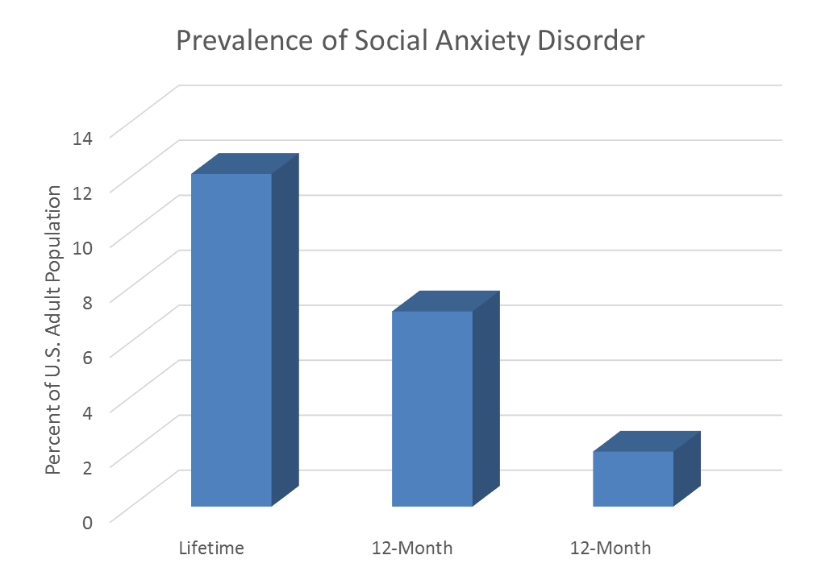
Facts About
Social Anxiety Disorder
Notes:
The purpose of this slide is to discuss the prevalence of social anxiety disorder.
In the United States, SAD affects approximately 12.1% of people in their lifetimes and 7.1% of adults in a given year. About 1 of every 4 people report at least one significant social fear in their lifetimes. SAD affects men and women about equally, and the majority of people with SAD report that their fears began in early adolescence, typically around age 13.
Reference:
Ruscio, A. M., Brown, T. A., Chiu, W. T., Sareen, J., Stein, M. B., & Kessler, R. C. (2008). Social fears and social phobia in the USA: Results from the National Comorbidity Survey Replication. Psychological Medicine, 38(1), 15–28. doi:10.1017/S0033291707001699

Slide 15
Overview
What is social anxiety?
How is social anxiety different from social anxiety disorder?
Safety Behaviors
Facts about social anxiety disorder
Components of Social Anxiety Disorder
  Fear of Evaluation
  Biased attention and interpretation
  Deficient Positive Experiences
  Problematic Emotion Regulation
Treatment
Notes:
Mid-lecture Overview
The purpose of this slide is to provide students with an overview of the material that will be covered during the lecture

Slide 16
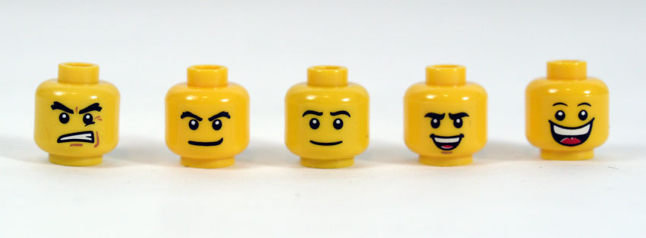
Components of
Social Anxiety Disorder
Fear of Evaluation
Biased Attention and Interpretation
Deficient Positive Experiences
Problematic Emotion Regulation
Notes:
The purpose of this slide is to introduce the four components of social anxiety disorder before delving into discussion questions regarding the disorder.
Theoretically, researchers hypothesize four main components that drive social anxiety disorder. Several of the components are related to the way a person perceives themselves or how they appraise certain situations differently from others. I’d like to take a moment before we get started to encourage you to really put yourself in the shoes of a person suffering from SAD to see how their mental processes are similar to or different from your own. In better understanding the behavior, we can do more to be empathic and caring with those we know suffer from the disorder.
(Click) Fear of Evaluation
Self-presentation theory: According to self-presentation theory, anxiety is the result of wanting to make a good impression, but doubting our ability to do so. With SAD, social situations seem like a hostile environment where others will be criticizing them. Since they tend to see themselves as having more flaws than others, navigating social situations becomes quite the anxiety-provoking event.
Overall, fear of negative evaluation is common to many disorders like depression but fear of positive evaluation is unique to SAD.
(Click) Biased Attention and Interpretation
Faster at detecting angry faces: Research shows that when people with SAD look at pictures of crowds, they are faster at detecting angry faces than people without SAD.
Biased away from positive cues: Not only are SAD sufferers quicker to recognize negative stimuli, but they have a tendency to ignore positive stimuli or cues. For example, they are less likely to notice smiling faces, pick up on hints for a 2nd romantic date, or understand that another person wants to spend more time with them.
(Click) Deficient Positive Experiences
A wealth of research indicates that we derive much of our happiness in life from positive, healthy interpersonal relationships. Since people with SAD have the tendency to avoid these interactions, this could mean a lower quality of life overall.
By studying people with SAD, we see that they
Spend less time engaging with others
Report social interactions as less pleasant
Report positive feelings during social interactions as less frequent
Experience less pleasure and intimacy, even in sexual relationships
(Click) Problematic Emotion Regulation
Emotion regulation refers to how people recognize, interpret, experience, and attempt to alter emotional states. In effect, by devoting effort to controlling emotions and minimizing the potential for rejection, a person paradoxically increases the likelihood of misunderstanding others or appearing aloof. Such encounters are also less enjoyable and possess less potential for deepening relationships.

Slide 17
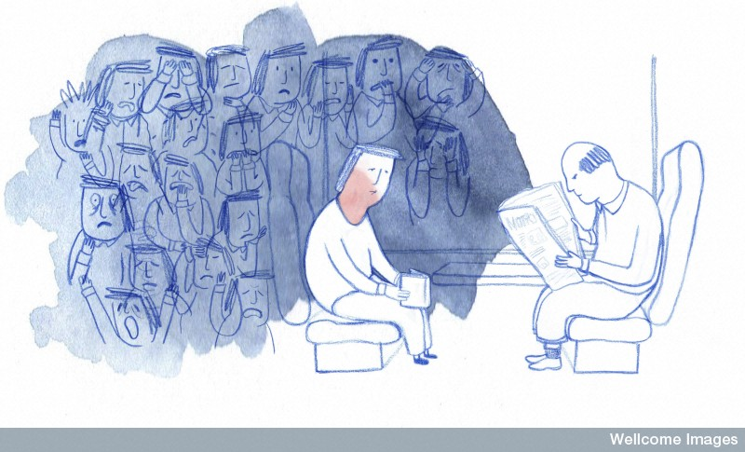
Conclusion
What is the hallmark of social anxiety disorder?
Notes:
The purpose of this slide is to point out the main component of SAD that differentiates it from normal social anxiety and lead-in to the discussion period.
What is the hallmark of social anxiety disorder?
Overall, research shows that the amount of social anxiety felt during social interactions was less important in distinguishing people with SAD from healthy adults than the intense effort put into avoid feeling anxious and infrequent positive emotions when spending time with other people.
Now you will ask students to think about two additional concepts related to SAD and discuss them in groups. You may choose one question or both questions, depending on the time needed. Expect each discussion to take about 10-15 minutes.

Slide 18
Discussion Questions
Discussion Question #1
  How does culture influence fears of negative and positive evaluation? After all, social groups differ in their adherence to a vertical social hierarchy.
Discussion Question #2
  Because the most effective treatment for social anxiety disorder is exposure to feared situations, what kinds of exposures would you devise for someone who fears talking in front of an audience? Engaging in small talk? Writing or eating in front of others? Speaking up in a small group? Talking to strangers?
Notes:
The purpose of this slide is to present the discussion questions to the students. Edit this slide if you are going to discuss only one of the questions.
(Click) Discussion Question #1: How does culture influence fears of negative and positive evaluation? After all, social groups differ in their adherence to a vertical social hierarchy.
Potential answers: Since fear of negative and positive evaluation are central to SAD, and these evaluations depend directly on social expectations (i.e., culture), we must consider a person’s cultural context in order to understand the disorder.
Prevalence rates of SAD are highest in the US and lowest in East Asian countries.
In America, Chinese-Americans are less likely to seek help for SAD than their counterparts of European descent.
Individualism v. collectivism – Two sides to the argument. In individualist societies people are more likely to seek help for SAD symptoms. In collectivist societies, the presence of stricter social norms may help those struggling with symptoms to better social adjustment. On the other hand, in cultures with stricter social norms, deviations from them are more pronounced and may lead to greater embarrassment.
(Click) Discussion Question #2: Because the most effective treatment for social anxiety disorder is exposure to feared situations, what kinds of exposures would you devise for someone who fears talking in front of an audience? Engaging in small talk? Writing or eating in front of others? Speaking up in a small group? Talking to strangers?
For this discussion, you may want to split students into groups and have each group consider only one of these scenarios. Then, you can come together as a class to share solutions.
Across all scenarios, students should mention starting out small and building to the full-blown experience.
Talking in front of an audience – Giving a speech over the phone, in a large empty room, with one audience member, with several, with a full room.
Engaging in small talk – writing down answers to commonly asked question; answering prescribed questions with a friend or stranger; attending an event and making small talk.
Eating in front of others – eating alone; eating alone in a restaurant far away from other people; eating with a friend; eating with a stranger

Slide 19
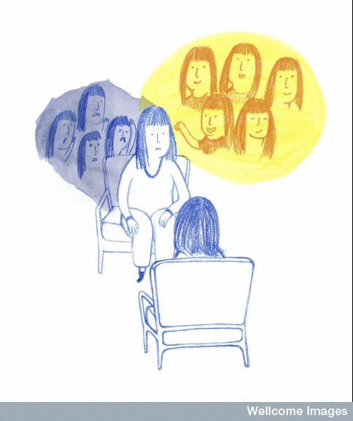
Diagnosing SAD
Notes:
The purpose of this slide is to serve as a placeholder/introduction for the Case Study activity. The materials for the activity are in the Instructor’s Manual.
Diagnosing SAD Activity: In this activity, students read through case studies of people suffering from SAD and identify critical components of the disorder.
Time: 30-45 minutes
Materials: See Appendix A for the three case studies to be used in this activity.
Directions: Students should answer the following questions about each case study they read. They can work individually or in groups. After working through, you could collect their answers OR you could discuss the correct answers in class.
Does this person show a fear of multiple social situations? If so, what types of situations are they afraid of?
In what ways does the person's fear disrupt their daily living?
Does the person recognize that their fear or anxiety is excessive?
What safety behaviors does this person engage in to avoid or deal with social situations?
How do these safety behaviors reinforce the person's fear?

Slide 20
Photo Attribution
Slide 1 | Photo Credit: girl Unsplash https://pixabay.com/en/girl-hipster-sexy-shy-hands-850117/ https://creativecommons.org/publicdomain/zero/1.0/deed.en
Slide 4 | Photo Credit: Man Speaking at a Town Hall Meeting Cade Martin http://www.public-domain-image.com/free-images/people/crowd/man-speaking-at-a-town-hall-meeting/attachment/man-speaking-at-a-town-hall-meeting Public Domain
Slide 5 | Photo Credit: Signs of Concern Kevin Chang https://www.flickr.com/photos/thekevinchang/3430946900 https://creativecommons.org/licenses/by-nc-nd/2.0/
Slide 7 | Image Credit: Created using information from: Ruscio, A. M., Brown, T. A., Chiu, W. T., Sareen, J., Stein, M. B., & Kessler, R. C. (2008). Social fears and social phobia in the USA: Results from the National Comorbidity Survey Replication. Psychological Medicine, 38(1), 15–28. doi:10.1017/S0033291707001699
Slide 8 | Photo Credit: Bullying 6ninjafox9 http://6ninjafox9.deviantart.com/art/Bullying-209662473 https://creativecommons.org/licenses/by-nc-nd/3.0/
Slides 9 & 10 | Photo Credit: DSC_0070-1 __Iain https://www.flickr.com/photos/27580645@N02/4404886083 https://creativecommons.org/licenses/by-nc-nd/2.0/
Slide 11 | Photo Credit: Point and Laugh ceoln https://www.flickr.com/photos/ceoln/4733628497 https://creativecommons.org/licenses/by-nc/2.0/
Slide 12 | Photo Credit: Illustrated silhouette of a black cat nehtaeh79 http://www.freestockphotos.biz/stockphoto/16624 http://creativecommons.org/publicdomain/zero/1.0/
Slide 14 | Image Credit: Created using information from: Ruscio, A. M., Brown, T. A., Chiu, W. T., Sareen, J., Stein, M. B., & Kessler, R. C. (2008). Social fears and social phobia in the USA: Results from the National Comorbidity Survey Replication. Psychological Medicine, 38(1), 15–28. doi:10.1017/S0033291707001699
Slide 16 | Photo Credit: Facial animation cycle BRICK 101 https://www.flickr.com/photos/fallentomato/8404227870 https://creativecommons.org/licenses/by-nc-sa/2.0/
Slide 17 | Photo Credit: B0009838 A man suffering from social anxiety disorder, illustration Wellcome Images https://www.flickr.com/photos/wellcomeimages/19923051058 https://creativecommons.org/licenses/by-nc-nd/2.0/
Slide 18 | Photo Credit: B0009841 Counselling for social anxiety disorder, illustration Wellcome Images https://www.flickr.com/photos/wellcomeimages/21866963940 https://creativecommons.org/licenses/by-nc-nd/2.0/
Notes:
Photo Attribution Slide

